Slide 1
Car Price Prediction Project
Presentation by: Kirti Ohlan

Slide 2
Abstract
A car price prediction has been a high interest research area, as it requires noticeable effort and knowledge of the field expert. Considerable number of distinct attributes are examined for the reliable and accurate prediction . To build a model for predicting the price of used cars the applied three machine learning techniques are Artificial Neural Network and linear regression Respective performances of different algorithms were then compared to find one that best suits the available data set. The final prediction model was integrated into Java application. Furthermore, the model was evaluated using test data and the accuracy of 88% was obtained

Slide 3
Data Collection
For accurate and real time analysis, Data is prepared from scratch.
Data is scrapped from ‘Cars24 website’.

Slide 4
Exploratory Data Analysis
01. Univariate Analysis
02. Multivariate Analysis
Univariate analysis is the simplest form of analyzing data. “Uni” means “one”, so in other words your data has only one variable.
Multivariate analysis is a set of statistical techniques used for analysis of data that contain more than one variable.
03. Correlation of Dataset
04. Correlation with Target variable
05. Conclusion
Correlation is used to test relationships between quantitative variables or categorical variables.
Correlation with the target variable to know how the data is related.
Summary with the conclusion of all the analysis

Slide 5

Univariate Analysis
Univariate analysis is the simplest form of analyzing data. “Uni” means “one”, so in other words your data has only one variable.

Slide 6
Selling Price of cars

Slide 7
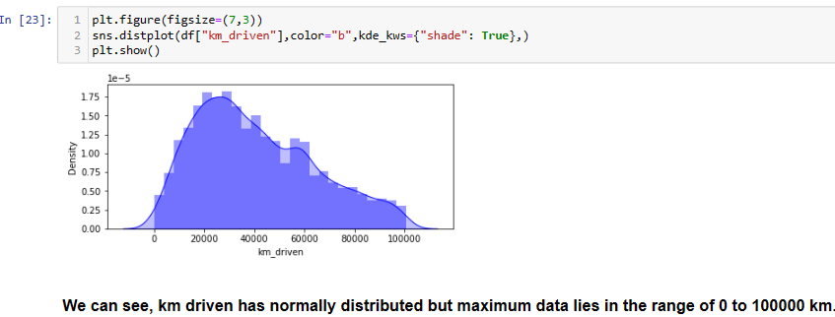
Kilometers Driven

Slide 8
Analysis of company names

Slide 9
Distribution plot

Slide 10

Multivariate Analysis
Multivariate statistics is a subdivision of statistics encompassing the simultaneous observation and analysis of more than one outcome variable.

Slide 11
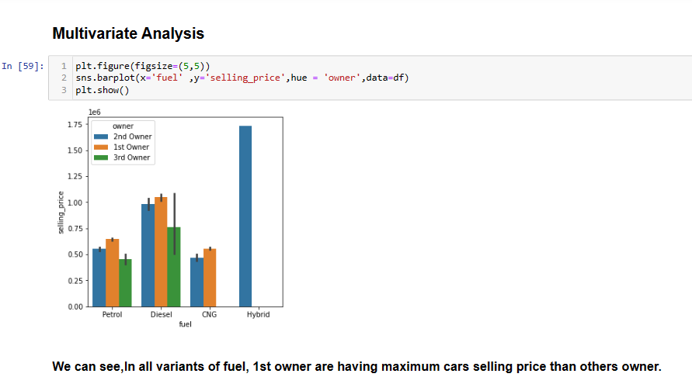
To analyze the relationship

Slide 12
Correlation of Dataset
We will observe the correlation of the data as per data in the data frame split. And Explanation at the last.

Slide 13
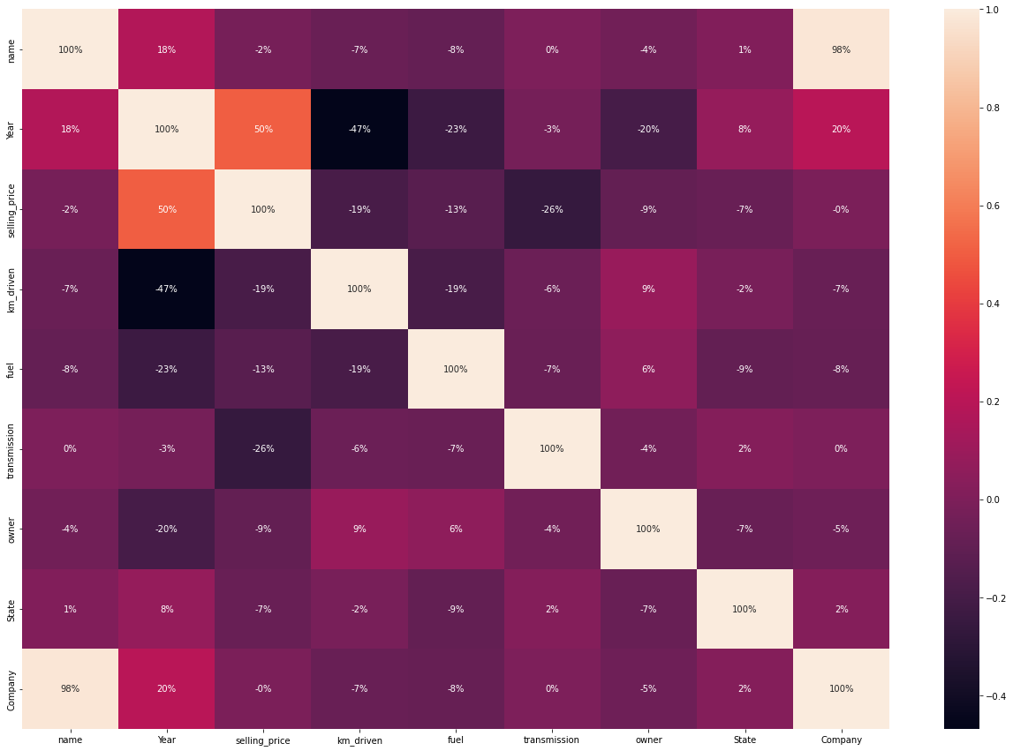
Correlation of Dataset

Slide 14
Key observations:
- Name, km_driven, fuel, transmission, owner are negatively correlated with target.
- year and company are positively correlated with target variable
- name is highly correlated with company
- maximum correlation : year
- minimum correlation : company

Slide 15
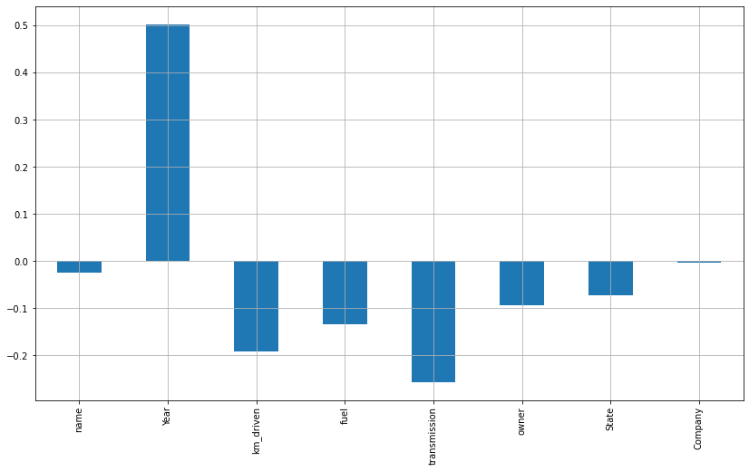
Correlation of Dataset

Slide 16
Conclusion
Since India’s used-car market is booming as buyers have a wide range of options, easy financing, convenient digital sales channels, and a growing preference for personal mobility in the COVID-19 era, car prediction can be a challenging task due to the high number of attributes that should be considered for accurate prediction. The main weakness of Gradient boosting is that it sacrifices intelligibility and interpretability. The main limitation of this study is the low number of records that have been used. In future work, we intend to collect more data related to electric vehicles and combustion vehicles and to use more advanced techniques.

